Slide 1

Debre Markos University Institute of Technology Information Technology Academy Program
Course Title: Data Communication and Computer Networks (ITec-3101)
Chapter: Two
Computer Network

Slide 2
Data communication
What is a computer network?
Applications & Uses of Networks
Networking Impacts In Our Daily Lives
Evolution of Network
Types of networks
Computer network components
Computer network design and management

Slide 3
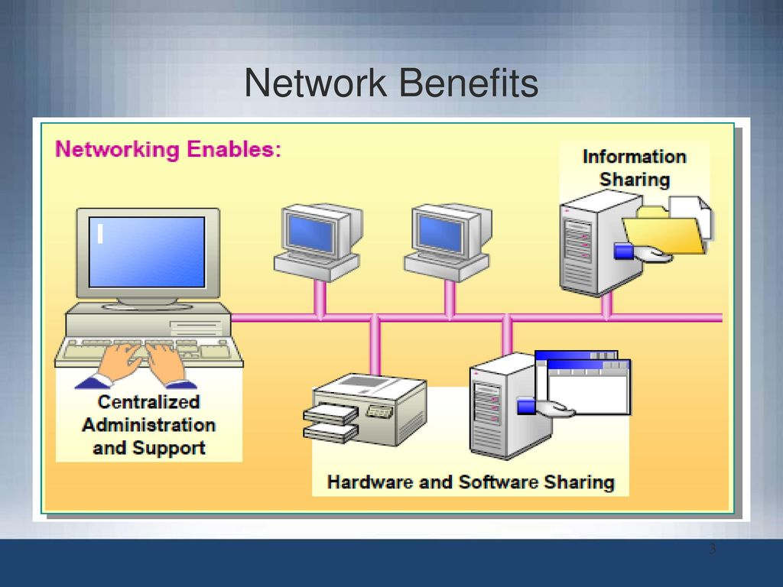
1. What is a computer network?
A computer network is a system in which a number of independent computers are linked together (wired, wireless) to:
Sharing Information and Resources (HW, SW), services
File, folder, printer, disk drive, internet
Client-server Configurations
Administration, sharing
E-commerce
Buying and selling
Communication
VOIP, Chatting, email

Slide 4
2. Applications & Uses of Networks
Marketing and sales
Financial services
Manufacturing
Electronic messaging
Directory services
Information services
Electronic data interchange (EDI)
Teleconferencing
Cellular telephone
Cable television

Slide 5
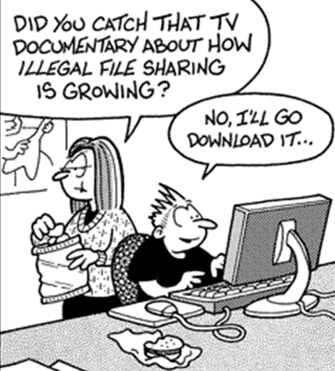
2. Applications & Uses of Networks
Disadvantages of computer network
Data security is therefore an important concern in a networked environment.
The danger of computer viruses entering the network is greatly increased.
Equipment malfunctions
System failures, media failure, server failure
Cost –
Hardware, software, setup
Management and administration

Slide 6
Networking Impacts In Our Daily Lives

Slide 7
3. Types of networks
Depending on one’s perspective, we can classify networks in different ways.
Based on transmission media: Wired (UTP, coaxial cables, fiber-optic cables) and Wireless
Based on network size: LAN, WAN, and MAN
Based on management method: Peer-to-peer and Client/Server
Based on topology (connectivity): Logical (Ethernet, token pass), physical (Bus, Star, Ring …)

Slide 8
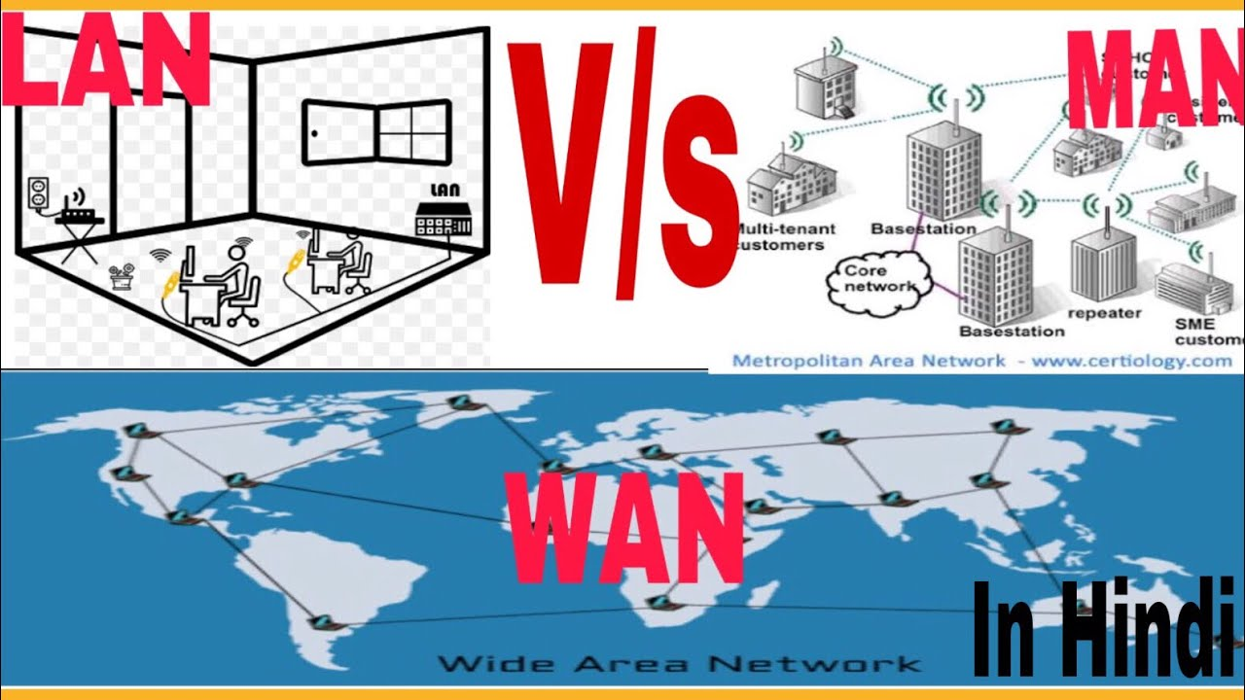
3. Types of networks
What are
Wireless Local Area Network (WLAN)
Campus Area Network (CAN)
Storage-Area Network (SAN)
System-Area Network (also known as SAN)
Personal Area Network (PAN)
Virtual Private Network (VPN)
Types of NW based on network size (coverage)
Local Area Networks (LANs)
Relatively small geographical area such as a home, an office, or a campus.
Owned, controlled, and managed by a single person or organization
Use certain connectivity technologies, primarily Ethernet and Token Ring.
Metropolitan Area Network (MAN)
It is a network that transmits data and information over city wide distance.
A network that is utilized across multiple buildings.
Is larger than a LAN, but smaller than a WAN. interconnection of several LANs
Wide area network (WAN)
has no geographical limit,
Ultimate WAN is the Internet
slower and less reliable than a LAN
Mostly owned by the public

Slide 9
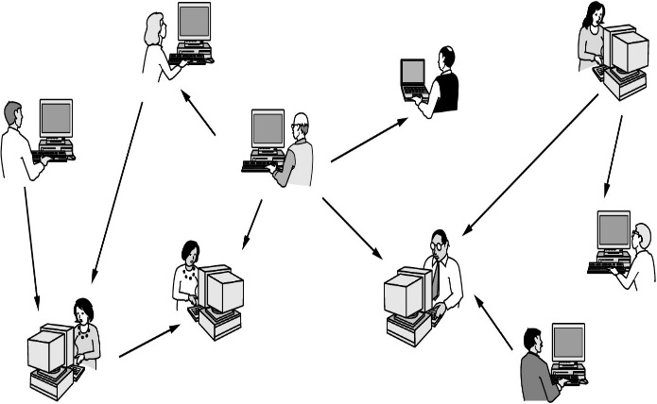
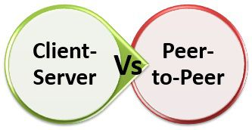
3. Types of networks
Types of networks based on node relationship / management
Peer-to-peer networks
Server-based networks
Peer-to-peer networks
No dedicated servers, and there is no hierarchy among the computers
All the computers are equal, Each computer functions as both a client and a server
Sometimes called workgroups.
Are relatively simple, less expensive than server-based networks
Users act as their own administrators and plan their own security
Peer-to-peer networks are good choices for environments where:
Less users (10 users or fewer), Users share resources, such as printers, but no specialized servers exist
Security is not an issue, only limited growth within the foreseeable future

Slide 10
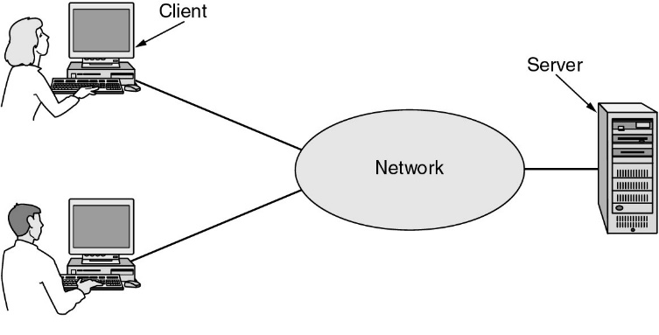
3. Types of networks
Server-based networks (client/server)
More computers (10 or more), have dedicated servers
May have separate servers for file storage, web, printing, email and for storing and running application software.
More complex to install, configure, and manage, a server-based network
Centrally administered and controlled
Security is often the primary reason for choosing, backups can be scheduled, support thousands of users

Slide 11
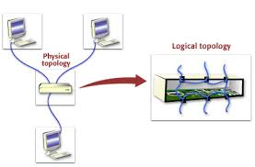
3. Types of networks
Network Topologies
physical topology –
Actual layout of the physical components such as computer, media etc.
The arrangement or physical layout / structure of computers, cables, and other components on the network,
Also called Physical layout, Design, Diagram or Map.
logical topology –
How the media is accessed by the hosts,
How data is transmitted between nodes or
How the network message is travel from one node to another

Slide 12
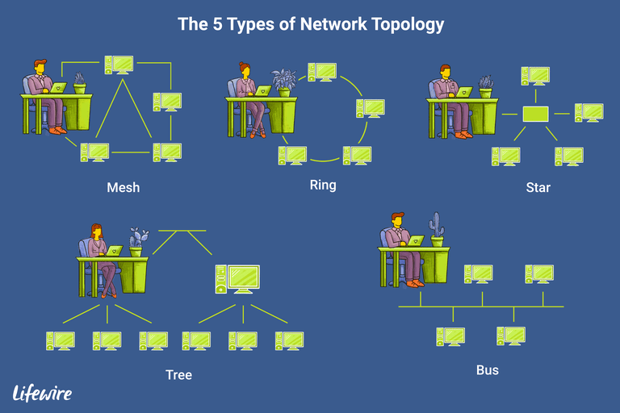
3. Types of networks
The choice of topology (Physical):
Type of equipment that the
network needs
Capabilities of the network
Growth of the network
Way the network is managed
Different types of cable, different network cards, network operating systems, how the cabling runs through floors, ceilings, and walls.
How computers communicate on the network.

Slide 13
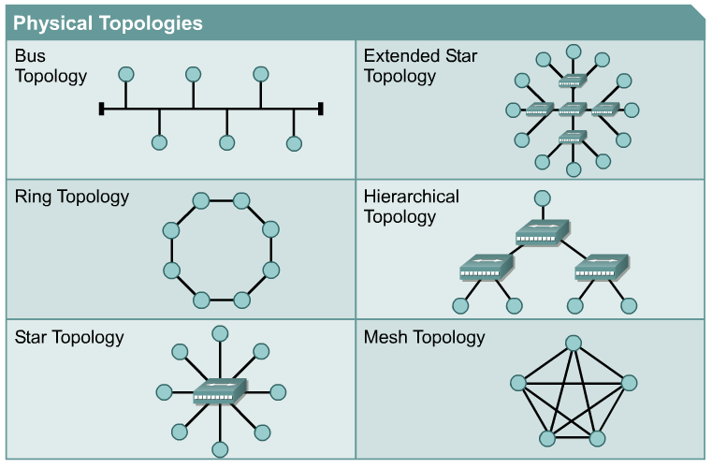
3. Types of networks
Physical Topology
Bus Topology
Star topology
Ring topology
Mesh topology
Hybrid topologies
Hierarchical
Extended star
Tree
. . . .

Slide 14
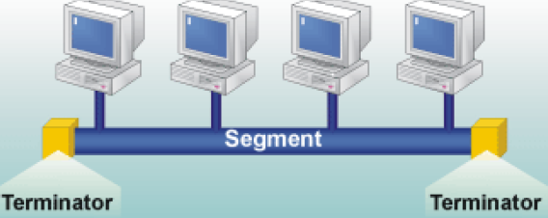
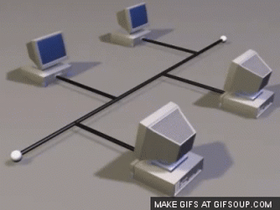
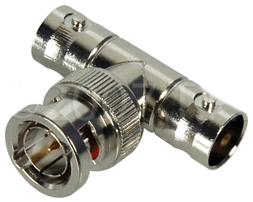
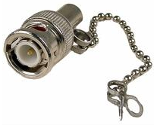
3. Types of networks
Bus Topology
linear bus , connected in a straight line, Inexpensive, simplest and most common, single cable called a trunk, also called a backbone or segment, Easily extended
Three concepts:
Sending the signal - signals to all the computer. if more computers, others waiting – so slower network, if one computer fails, it does not affect the rest of the network
Signal bounce - bouncing back and forth along the cable and prevent other computers from sending signals - collision or noise - must be stopped
Terminator - placed at each end of the cable to absorb free signals / To stop bouncing. if a break in the cable occurs so the signal will bounce, and all network activity will stop
Bus topologies use coaxial cable. T connectors are often used to connect the computer to the trunk cable.

Slide 15
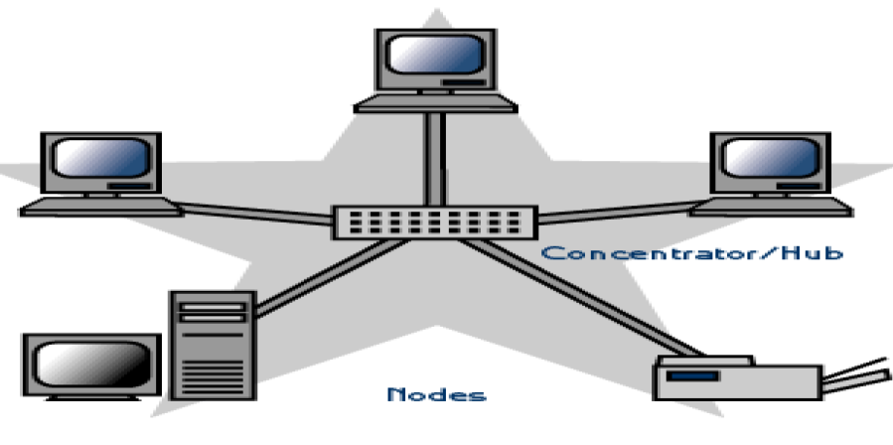
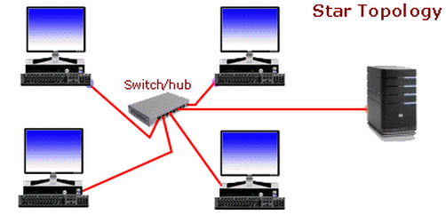
3. Types of networks
Star topology
Each computer are connected to a centralized component called a concentrator, making it very easy to add a new workstation
Requires a great deal of cable
Most common network configuration in use today
If the central point/device fails, the entire network goes down
If one computer or the cable fails. The rest of the network continues to function normally.
Are more expensive to install than bus networks, because there are several more cables
Plus the cost of the concentrator / hubs

Slide 16
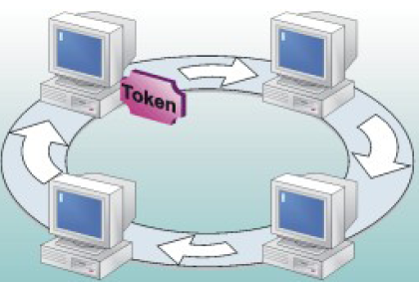
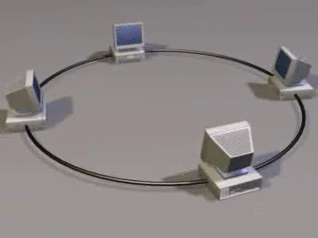
3. Types of networks
Ring topology
Connects computers on a single circle of cable
Each node is connected to the two nearest nodes so the entire network forms a circle.
Signals travel around the loop in one direction and pass through each computer (act as a repeater).
failure of one computer can have an impact on the entire network
One method for passing data on ring networks is token passing.
Easier to manage
Easier to locate a defective node or cable problem
In short ring topology enables reliable communication
Expensive, requires more cable and network equipment at the start, not used as widely as bus topology
only one computer at a time can send

Slide 17
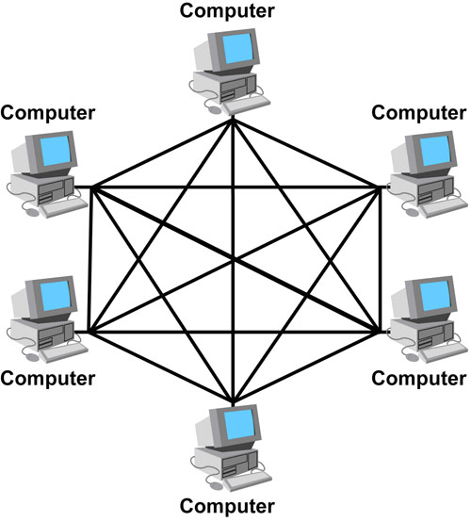
3. Types of networks
Mesh topology
Offers superior redundancy and reliability
Each computer is connected to every other computer by separate cabling.
If one cable fails, another will take over the traffic
Ease of troubleshooting and increased reliability
Are expensive to install because they use a lot of cabling
Used in conjunction with other topologies to form a hybrid topology
The simplest logical topology in terms of data flow, but it is the most complex in terms of physical design
If there are x computers, there will be (x × (x–1)) ÷ 2 cables

Slide 18
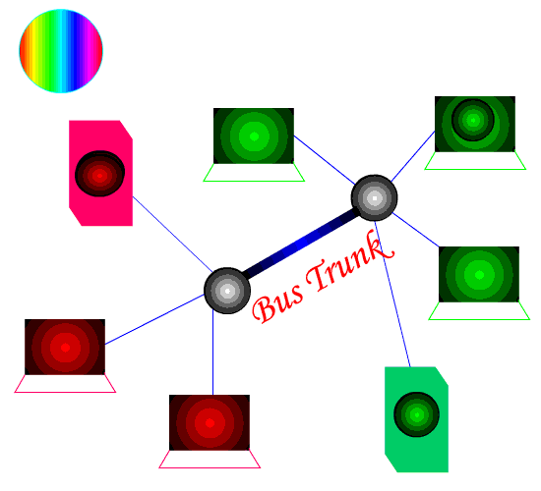
3. Types of networks
Hybrid topologies (star-bus, star-ring, extended-star, tree . . .)
Star bus topology
If one computer goes down, it will not affect the rest of the network. The other computers can continue to communicate.
If a hub goes down, all computers on that hub are unable to communicate
Star ring topology
The star ring (sometimes called a star-wired ring) appears similar to the star bus.
Both the star ring and the star bus are centered in a hub that contains the actual ring or bus

Slide 19
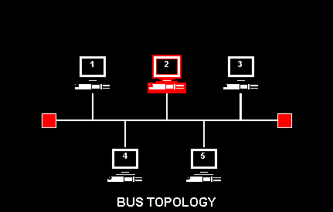
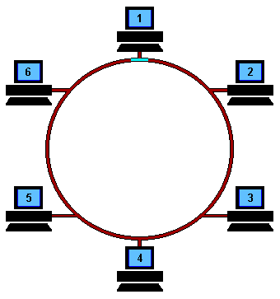
3. Types of networks
Logical Topologies
Defines how the hosts communicate across the medium
The two most common types of logical topologies are:
Broadcast topology / Ethernet
Each host sends its data to all other hosts on the network medium.
It is first come, first serve FIFO.
Commonly supported by networks that use a bus, a star, or a star-wired bus physical topology
Token passing
Controls network access by passing an electronic token sequentially to each host.
When a host receives the token, that host can send data on the network.
Two examples of networks that use token passing are Token Ring and Fiber Distributed Data Interface (FDDI).

Slide 20
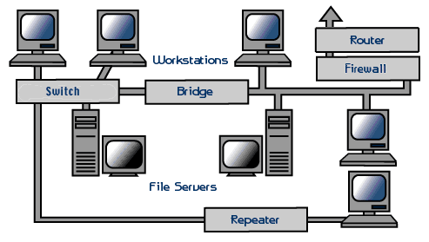
4. Computer network components
Two basic components
Hardware
Software
Hardware –
All physical parts that we can see and touch
Server
Workstation / Client / dump Terminals
Transmission media / Medium
Network Interface Cards (NIC) - transmitter” and “receiver” – transceiver. It use MAC address can be wired or wireless. PCI slot (desktop) and ExpressCard slots (laptop)
A concentrator / network connectivity devices / internetworking devices, or wiring center

Slide 21
4. Computer network components
A concentrator / network connectivity devices
Hub –
Hubs can be: A passive hub, An active hub, A switched hub
Currently Hubs are becoming obsolete and replaced by more advanced communication devices such as Switches and Routers
Switch –
amplify the signal as it moves from one device to another
Managed switch and unmanaged switch
Repeaters - amplifies the signal it receives and rebroadcasts it
Bridges - segment a large network into two smaller, more efficient networks
Routers - translates information from one network to another; it is similar to a super intelligent bridge
Gateway - A gateway is a translation tool. It is a server that acts as an intermediary for some other server.

Slide 22
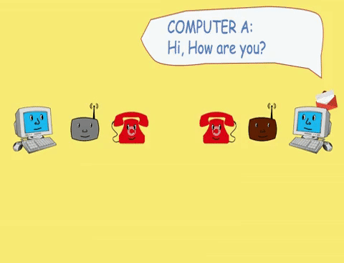
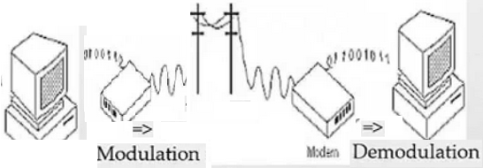
4. Computer network components
Modems –
For internet connection over the existing telephone line.
Can be installed on the PCI slots found on motherboard.
It is not necessary for LAN, but required for internet connection such as dial-up and DSL.

Slide 23
4. Computer network components
User
Application Software
Operating System
Hardware
Software
Network operating system (NOS)
Peer-to-peer (such as Windows for Workgroup ) and client server (Windows 2012 Server )
The operating system of the workstation – (WOS) - such as windows 10
Application Software
Server software - web server, mail server, print server, file server, database server
Client software - web browsers, e-mail clients

Slide 24
5. Computer network design and management
Network Design
Identify the organizational objective and the goal of the network to be developed
The most typical technical goals in an enterprise LAN/WAN design
Scalability – appropriate size or volume, minimal cost
Availability - 7 / 24 or according to need. Fast User Interface, Application availability
Performance / Reliability - capacity utilization, throughput, and delay
Security – policy, Roles and Privileges
Flexibility - Easy User Management, Handling Multiple Time-zones, Maintenance scheduling

Slide 25
5. Computer network design and management
First decide whether a peer-to-peer or a server-based network.
Factors:
Size of the network.
Level of security.
Type of business.
Level of administrative support available.
Amount of network traffic.
Needs of the network users.
Network budget.

Slide 26
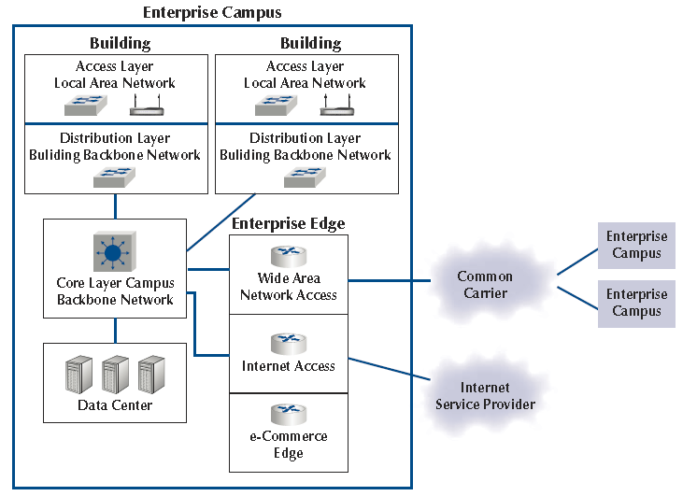
5. Computer network design and management
Example: Network Architecture

Slide 27
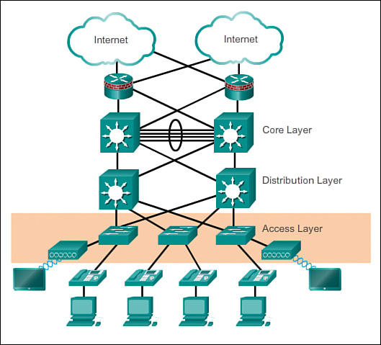

Slide 28
5. Computer network design and management
Components in the above Architecture
The first is the local area network (LAN), which enables users to access the network / access layer
The second is the building backbone network, which some vendors call the distribution layer, because it distributes
The third is the campus backbone (sometimes called the core layer), which connects all campus buildings.
The fourth is the data center, which contains the organization’s servers (e.g., db. servers, email servers).
The last three make up the enterprise edge, an enterprise campus connect with the rest of the world.
The wide area network (WAN). A WAN is a private network that connects its different campus locations.
The Internet access component, which enables the organization to connect to the Internet.
The e-commerce edge. enables electronic data exchange between the organization and the external entities.

Slide 29
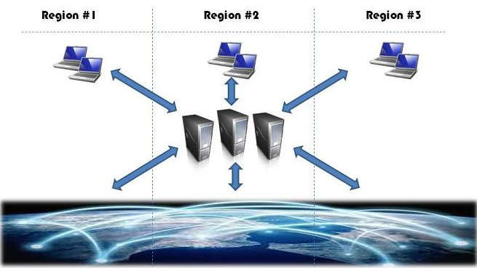
5. Computer network design and management
Network Management Architecture
Centralized
Distributed
Hierarchical
Centralized Network Management Architecture
A single management system installation monitors the whole network.
This installation may consist of one or more servers due to hardware limitations.
If more than one server is used, it is considered as a centralized architecture when all servers are located at the same NOC.
Network Architecture: The design of a network, including the hardware, software, access methods, and the protocols in use.

Slide 30
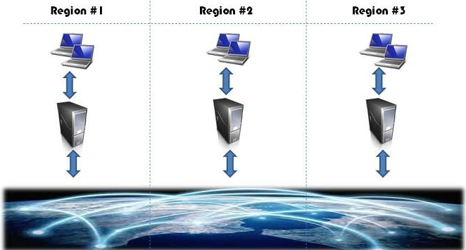
5. Computer network design and management
Distributed Network Management Architecture
Multiple installations of management systems are used to monitor the whole network.
Each management system is installed at a NOC that is responsible to monitor a geographical or administration region / domain, i.e. it is a Domain Manager.

Slide 31
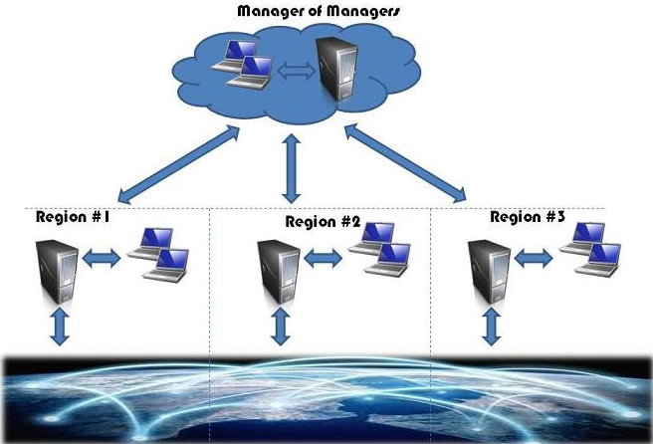
5. Computer network design and management
Hierarchical Network Management Architecture
Multiple installations of management systems are used to monitor the whole network.
Each management system is installed at a NOC that is responsible to monitor, it is a Domain Manager.
It adds an additional layer, the Manager of Managers (MoM).
MoM sits at a higher level and requests information from domain managers.
There is no communication between domain managers, information flow follows the hierarchy.
The hierarchy can be further expanded by adding additional layers of MoMs and therefore is quite scalable.

Slide 32
Criteria | Centralized | Distributed | Hierarchical
Reliability | Depends on Data Communications Network infrastructure (DCN), due to connectivity between regions. | Very Reliable, no single point of failure. Regions are independent. | Very Reliable and scalable. Regions are independent but also centrally monitored.
Scalability | Depends on DCN: as the network expands the DCN bandwidth between regions increases | Very Good, just add servers to increase the managed network size | Excellent, add servers to increase the managed network size and Manager of Managers for control
Flexibility | Limited, only one time-zone is possible per server, regions must follow the central region maintenance schedule | Very Flexible, can handle different time-zones; each region can schedule independent maintenance actions | Very Flexible, can handle different time-zones; each region can schedule independent maintenance actions
User Experience | Depends on DCN, as DCN performance affects client’s remote access to servers | Very Good, local access to servers ensures UI speed and responsiveness | Excellent, local access to servers ensures User Interface speed and responsiveness. MoM gives end-to-end visibility
Overall | Good | Better | Best

Slide 33
5. Computer network design and management
Selecting a Logical Network Topology
Identify the network segments and interconnection points between segments, size and scope of networks, and the types of required internetworking devices
Preferable: develop a layered and hierarchical design model
A typical hierarchical network topology includes the following three layers:
A core layer consisting of high-end routers and switches that are optimized for availability and performance
A distribution layer of routers and switches that implement network policies
An access layer that connects users via hubs, switches, and other interconnection devices

Slide 34
5. Computer network design and management
Requirements of the Network
Define requirements to the existing hardware, software, and telecommunications. At a minimum, you should consider the following:
The size of the facility (located on a single floor vs. multiple floors)
The number of users
Whether the LAN will be extended to several buildings
The environment (office, manufacturing, out-of-doors)
The current network media, if any
The technical competence of users
The amount of network traffic (initially, and anticipated for the future)
The level of security

Slide 35
5. Computer network design and management
Network Management
Network administrators need tools to monitor the functionality of the network devices, the connections between them, and the services they provide. SNMP is de facto standard with RMON and BIM
Network Management Architecture
Network management system (NMS): A system that executes applications that monitor and control managed devices. NMSs provide the bulk of the processing and memory resources that are required for network management.
Network management protocol: A protocol that facilitates the exchange of management information between the NMS and managed devices, including SNMP, MIB, and RMON.
Managed devices: A device (such as a router) managed by an NMS.
Management agents: Software, on managed devices, that collects and stores management information, including SNMP agents and RMON agents.
Management information: Data that is of interest to a device’s management, usually stored in MIBs.

Slide 36
5. Computer network design and management
Protocols and Standards
SNMP - how management information is exchanged between network management applications and management agents
Manager - there is a trade-off between polling frequency and bandwidth usage
Protocol - SNMP is a protocol for message exchange, It uses the UDP
Managed device - A device (such as a router) managed by the manager.
Management agents - SNMP management agents reside on managed devices to collect and store a range of information about the device and its operation
MIB - a database of objects about the device. Is a collection of managed objects
RMON - allows packet and traffic patterns on LAN segments to be monitored
NetFlow
CDP
Syslog

Slide 37
5. Computer network design and management
MIB
A MIB is a collection of managed objects.
A MIB stores information, which is collected by the local management agent, on a managed device for later retrieval by a network management protocol.
Each object in a MIB has a unique identifier that network management applications use to identify and retrieve the value of the specific object.
The MIB has a tree-like structure in which similar objects are grouped under the same branch of the MIB tree.
For example, different interface counters are grouped under the MIB tree’s interfaces branch.

Slide 38
5. Computer network design and management
RMON
RMON is a MIB that provides support for proactive management of LAN traffic.
The RMON standard allows packet and traffic patterns on LAN segments to be monitored. RMON tracks the following items:
Number of packets
Packet sizes
Broadcasts
Network utilization
Errors and conditions, such as Ethernet collisions
Statistics for hosts, including errors generated by hosts, busiest hosts, and which hosts communicate with each other
Without RMON, a MIB could be used to check the device’s network performance
RMON agents can reside in routers, switches, hubs, servers, hosts, or dedicated RMON probes

Slide 39
5. Computer network design and management
NetFlow
Cisco NetFlow is a measurement technology that measures flows that pass through Cisco devices
Answers the questions of what, when, where, and how traffic is flowing in the network
NetFlow-collected data serves as the basis for a set of applications, including
Network traffic accounting
Usage-based network billing
Network planning
Network monitoring

Slide 40
5. Computer network design and management
CDP
is a Cisco-proprietary protocol that operates between Cisco devices at the data link layer.
CDP information is sent only between directly connected Cisco devices; a Cisco device never forwards a CDP frame.
CDP provides a summary of directly connected switches, routers, and other Cisco devices.

Slide 41
5. Computer network design and management
Syslog
It alerts you when something goes wrong or down in your network.
Syslog is an excellent tool for system monitoring and is almost always included in your distribution
Level | Keyword | Description
0 | emergencies | System is unusable
1 | Alerts | Immediate action is needed
2 | Critical | Critical conditions exist
3 | Errors | Error conditions exist
4 | Warnings | Warning conditions exist
5 | Notification | Normal, but significant, conditions exist
6 | Informational | Informational messages
7 | Debugging | Debugging messages

